Slide 1

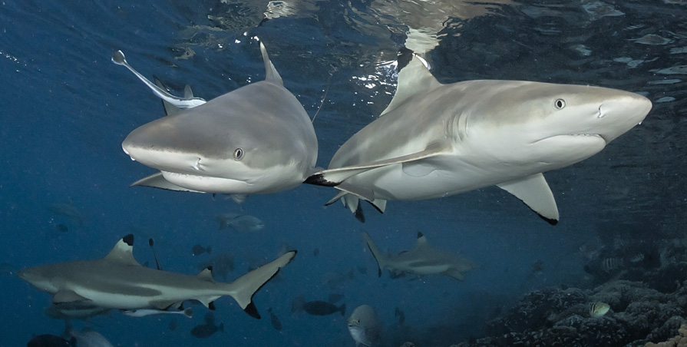
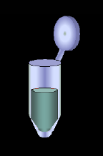





Inferring social behaviour and mating patterns in a reef shark from social network and molecular analyses
Dr. Johann MOURIER
& Serge PLANES
Laboratoire d'Excellence « CORAIL »
USR 3278 EPHE-CNRS, CRIOBE
Centre de Biologie et d'Ecologie Tropicale et Méditerranéenne

Slide 2
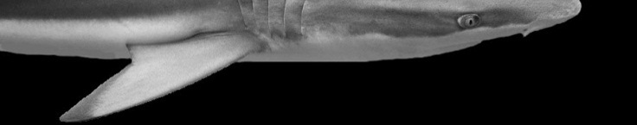
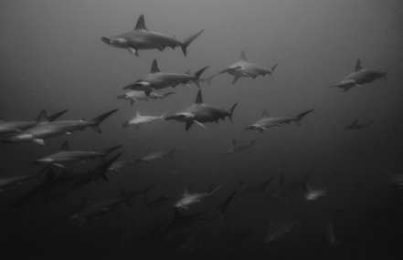
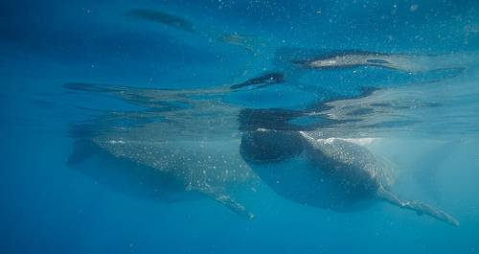
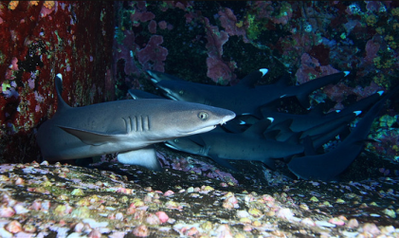
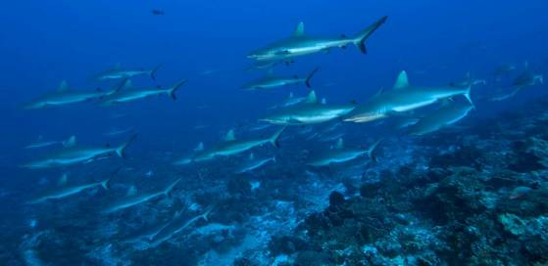
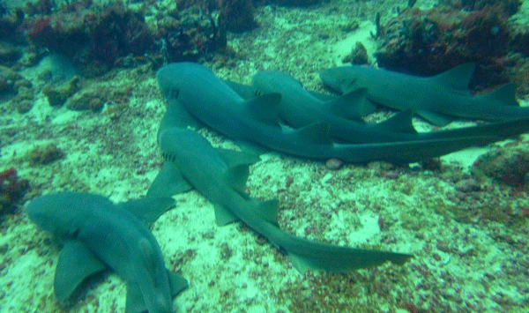
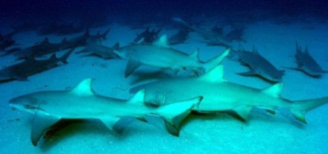
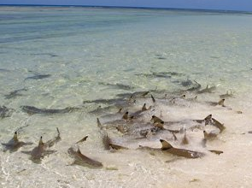
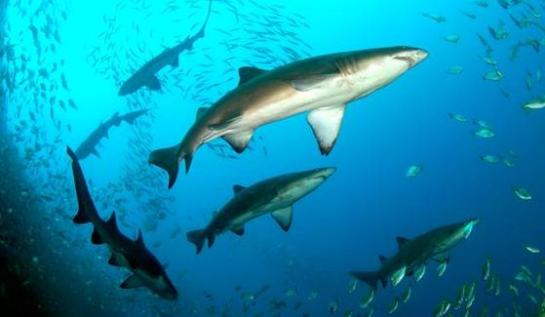
Context
Many shark species aggregate.
Reef-associated sharks often show strong patterns of site fidelity : a prerequisite for sociality?
Limited empirical evidence that such grouping is socially driven.
Interplay between dispersal strategies, genetic structure and social behaviour?
Understanding the assortative forces behind the structural properties of shark populations.

Slide 3
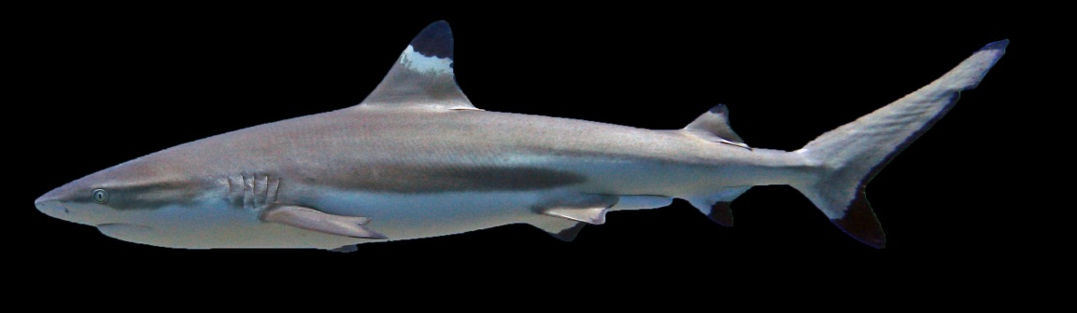
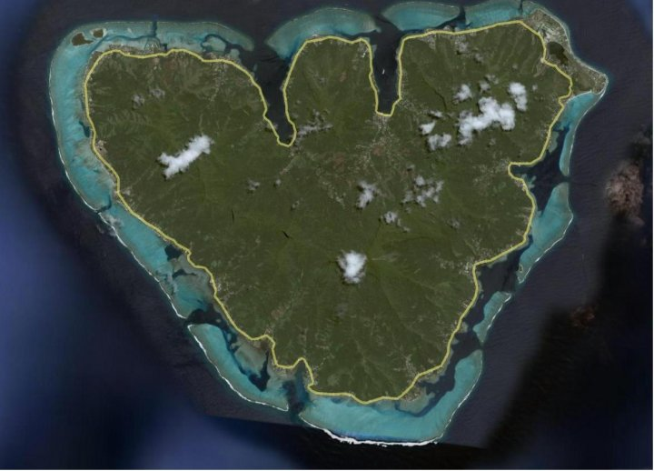

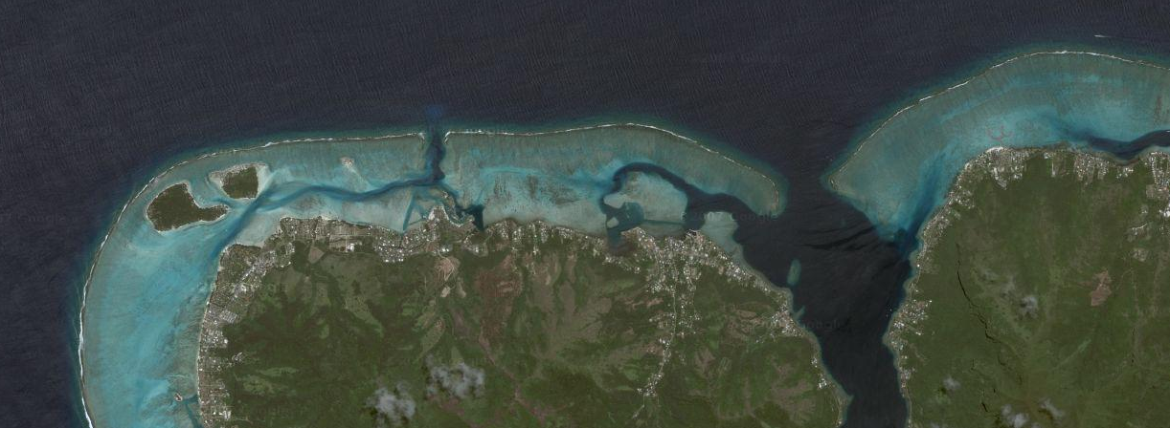


Previous results from acoustic telemetry around Moorea:
Small home range and spatial overlap
Cyclicity in diel movements
Low interaction rate between populations of the 3 coasts of Moorea
Repeated interactions = prerequisite for social behaviour to evolve?
Study site
4
3
1
2
5
6
7
1 km

Slide 4
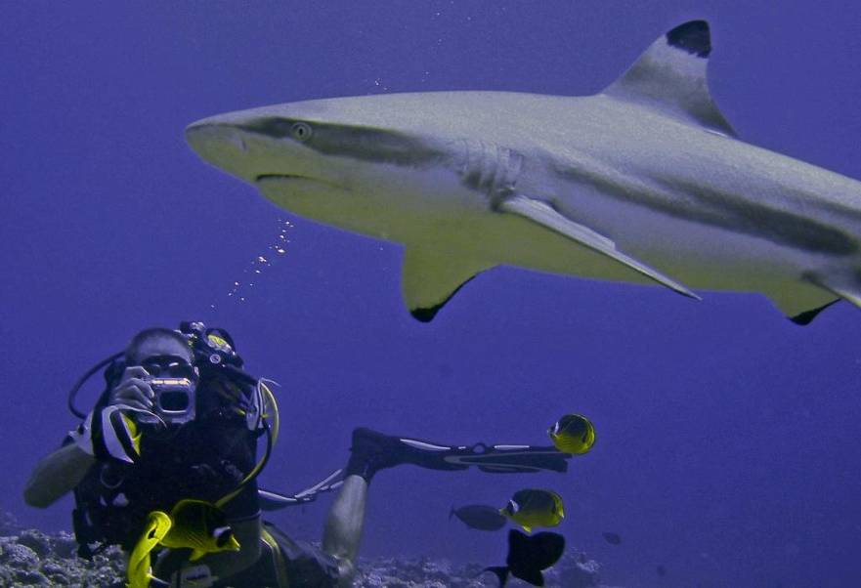
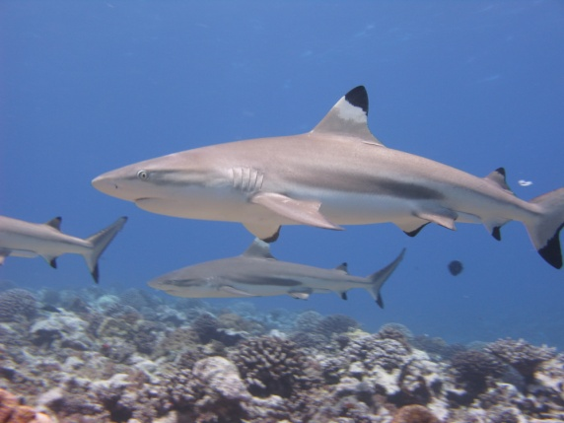
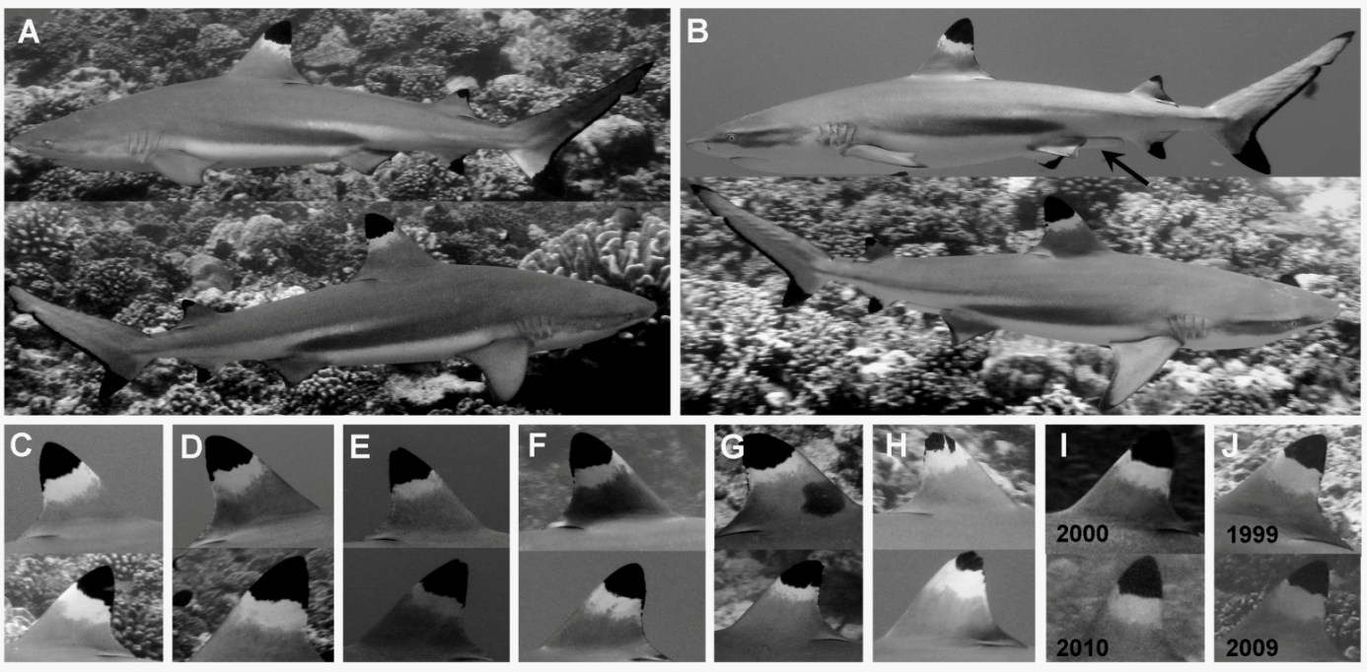
Photo-identification
Association index ~ number of time two sharks are associated
Identify individuals and follow them in time and space…
241 individuals identied over 190 dives (2008-2010)
133 individuals observed more than 4 times

Slide 5
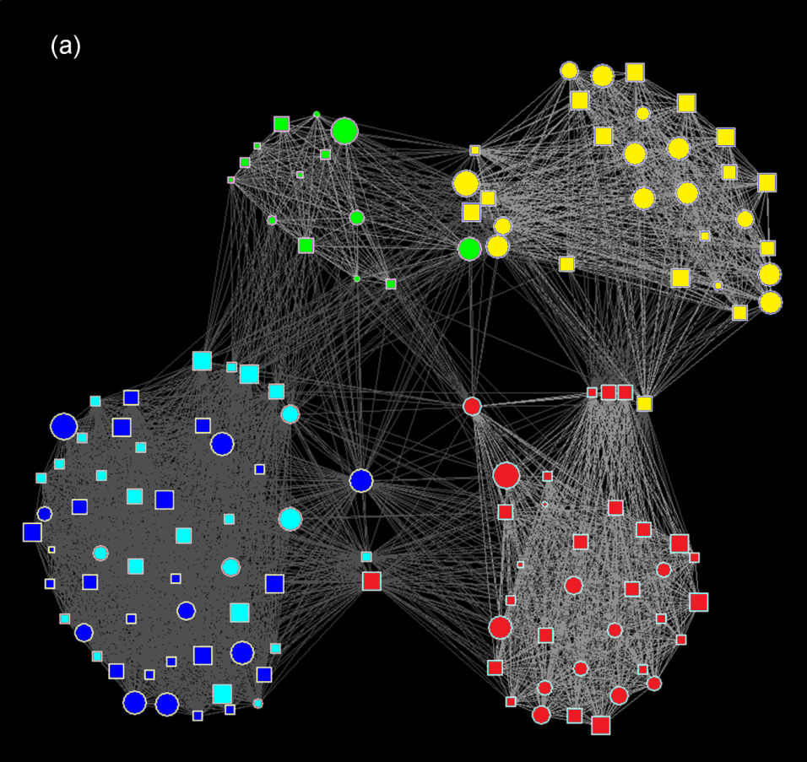
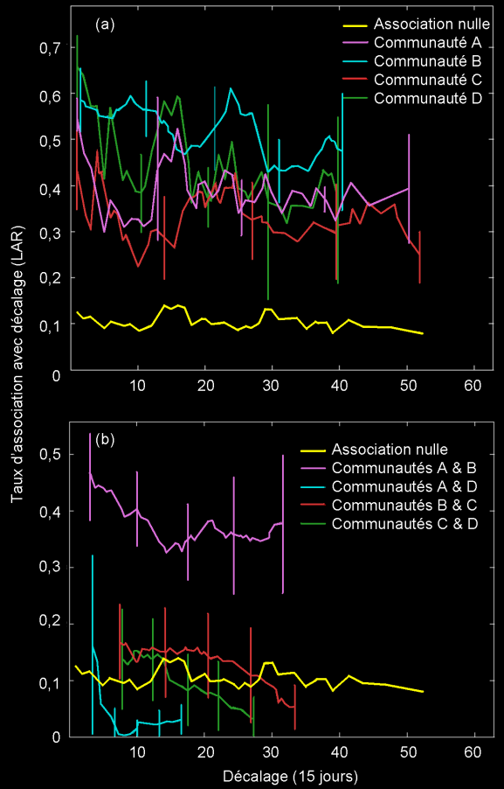
4 communities (one including 2 sub-communities)
Temporally stable associtions within communities
Mourier et al. 2012_Animal Behaviour
Temporally unstable associations between communities

Slide 6


4
3
1
2
5
6
Some spatial overlap between communities!
7
1 km
… 32% of the 190 observations were composed of individuals from different communities
=> mainly during the mating season.

Slide 7
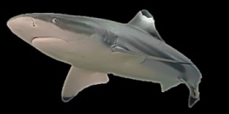
A dynamic network
Genetic relatedness:
Low mean relatedness (R=0.06) but:
Intra community vs. Inter community
Global (*)
R Intra > R Inter
Male-Male (**)
R Intra > R Inter
Female-Female
R Intra ~ R Inter
Male-Female
R Intra ~ R Inter
Community
Individual
Non mating season

Slide 8
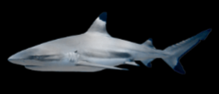
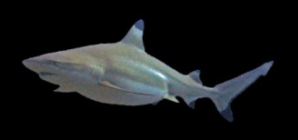
What is happenning during the mating season?
Input
25%
Males + Females
Males + Females
Output
26%
Pregnant females

Slide 9
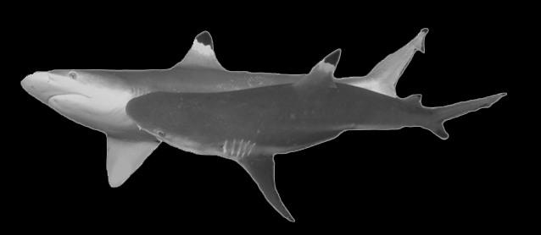
Genetic relatedness:
Low mean relatedness (R=0.06) but:
Intra community vs. Inter community
Global
R Intra > R Inter
Male-Male (*)
R Intra > R Inter
Female-Female
R Intra ~ R Inter
Male-Female
R Intra ~ R Inter
Community
Mating season
?
But R intra community (Mating) ~ R intra community (NonMating)
inefficient inbreeding avoidance strategy

Slide 10
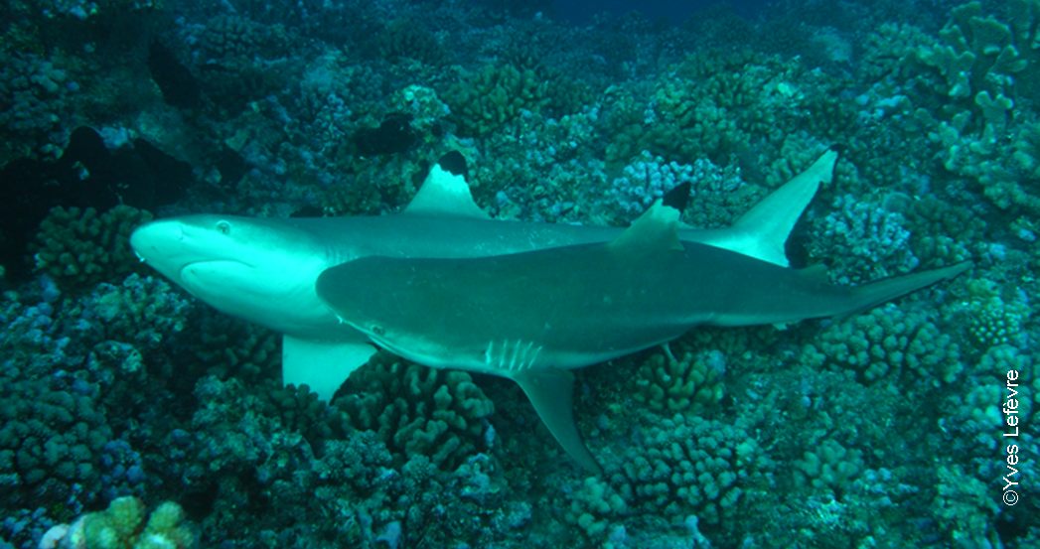
What is the breeding behaviour?
Direct genetic evidence for reproductive philopatry and associated fine-scale migrations in female blacktip reef sharks

Slide 11
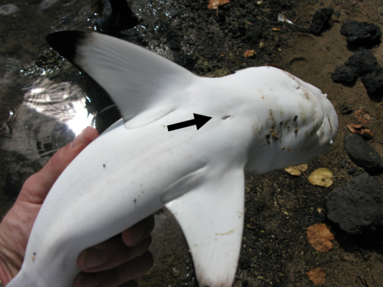
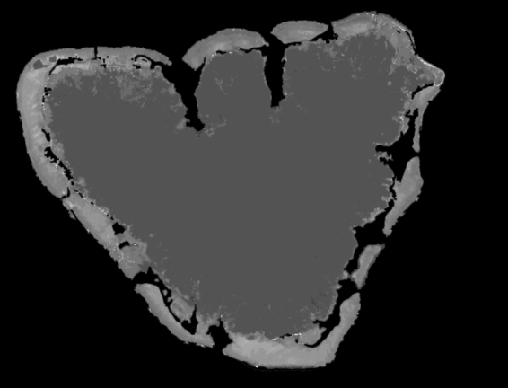
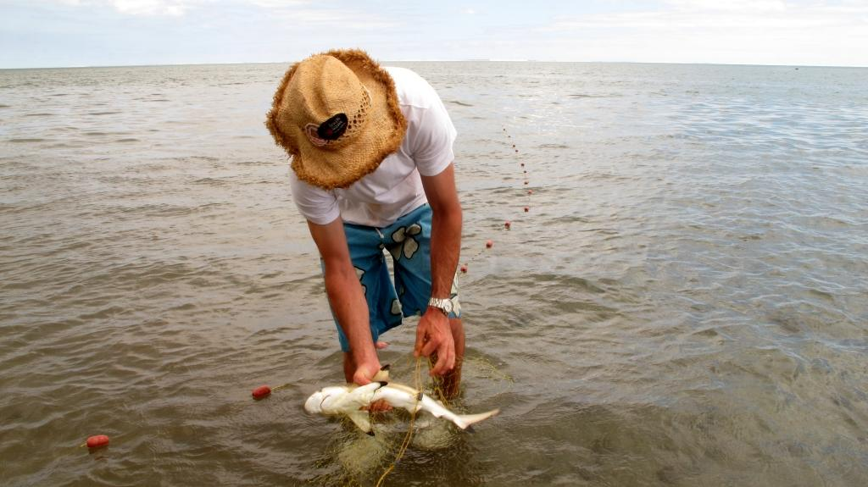
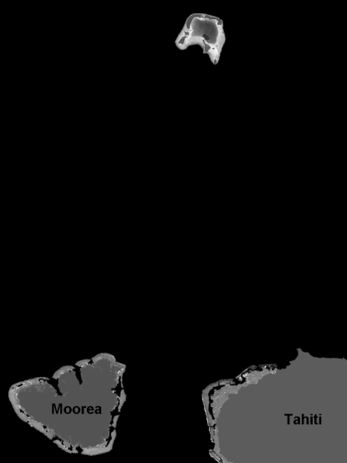
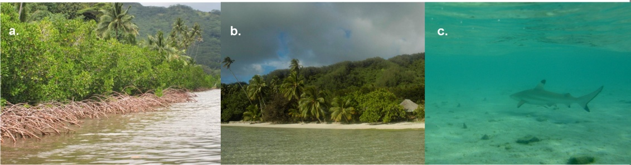
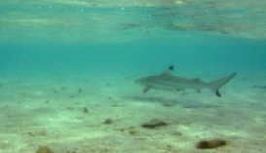
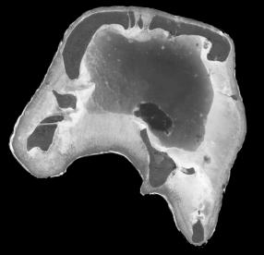

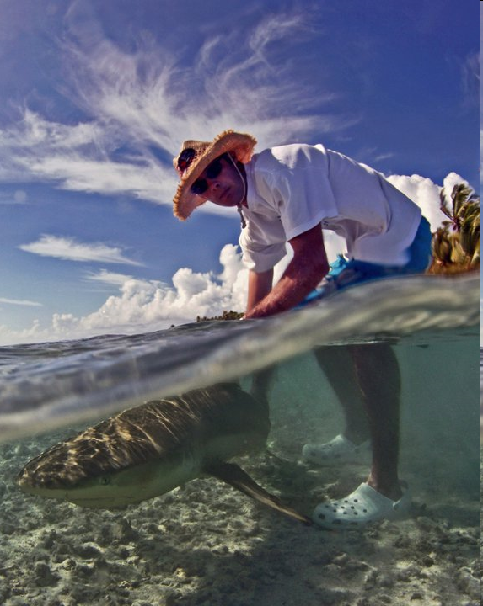
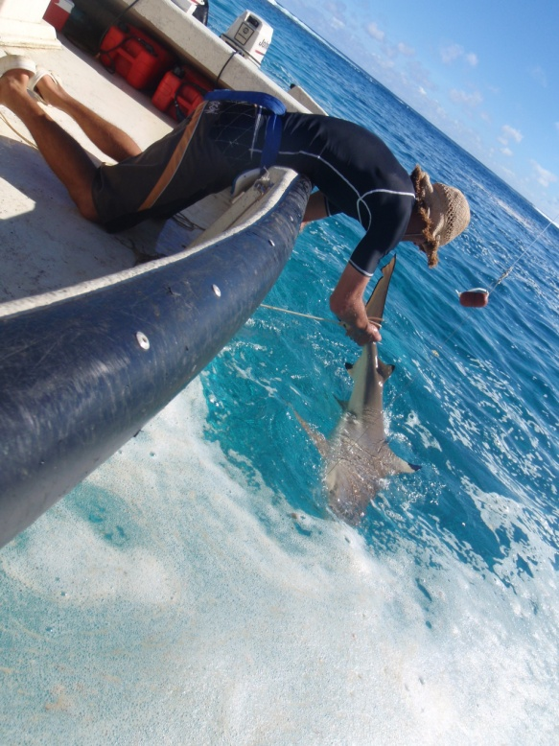
Genetic Parentage Analyses
+ Tetiaroa:
15 juveniles
2 adults
60 sampled juveniles
N
Nursery areas ≠ females’ home range
Which females use these nursery? Where do they come from?
+
10 km
180 sampled adults

Slide 12
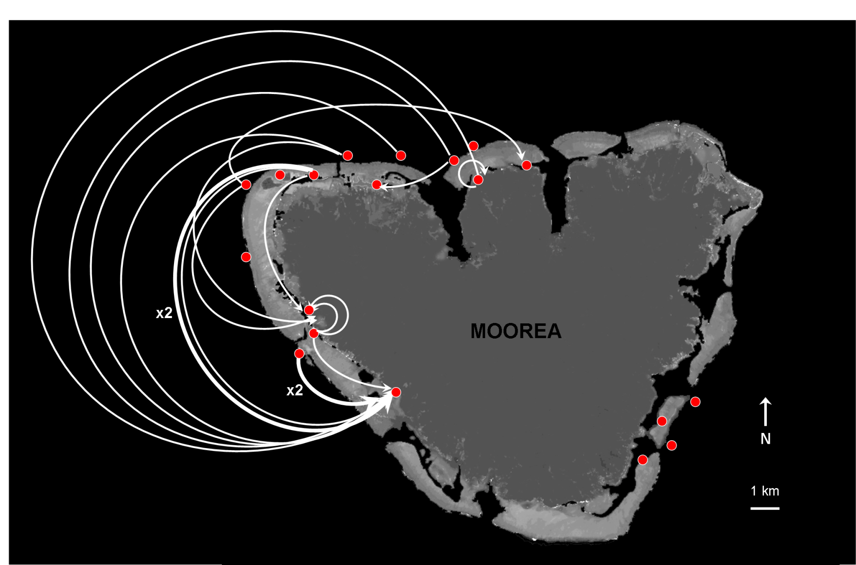
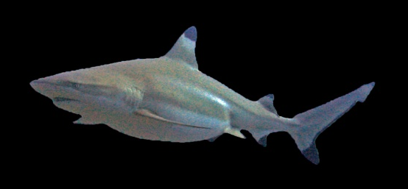
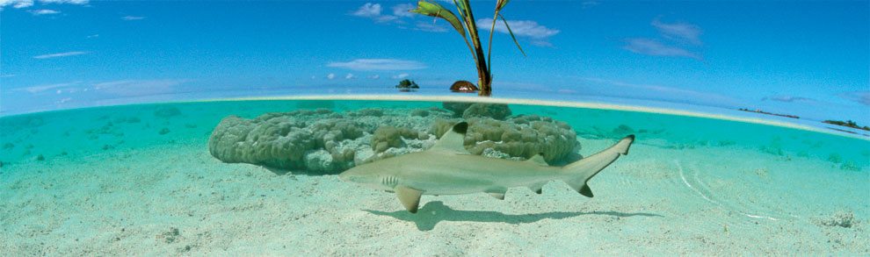
Fine-scale females migrations to their nurseries

Slide 13
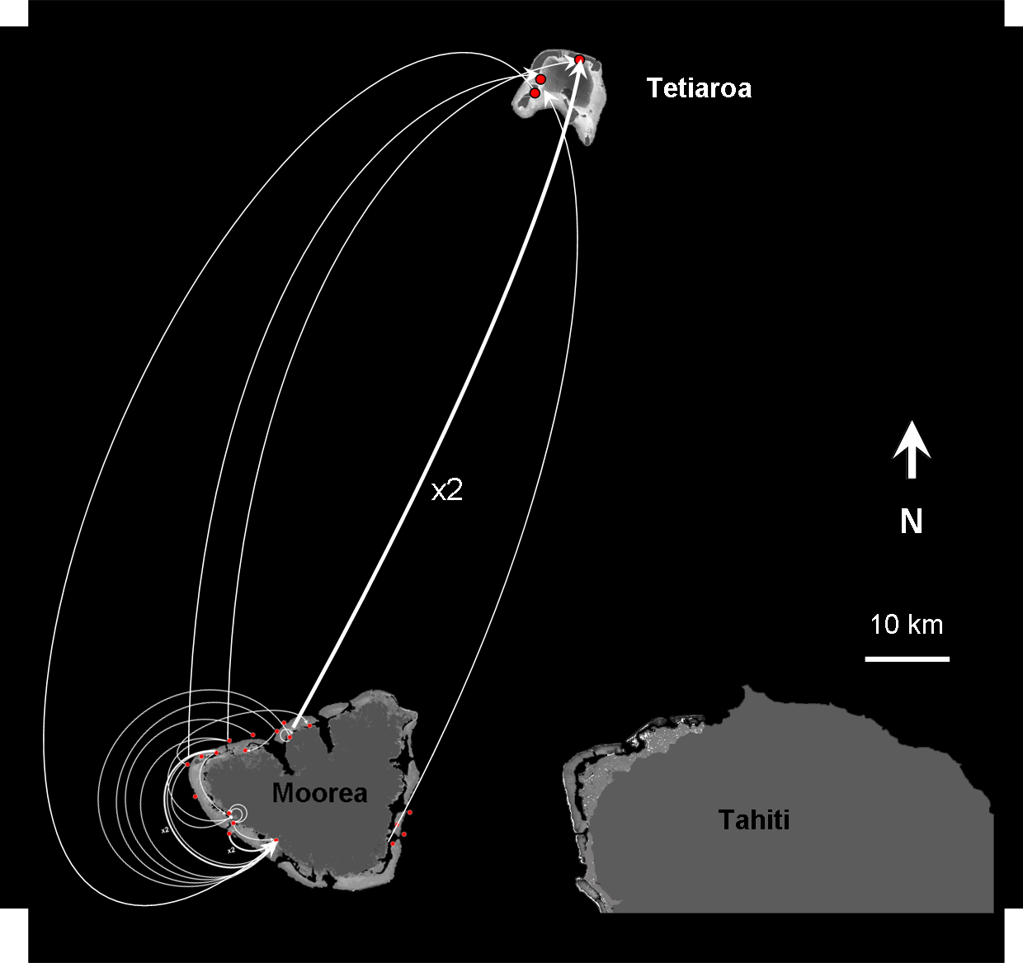
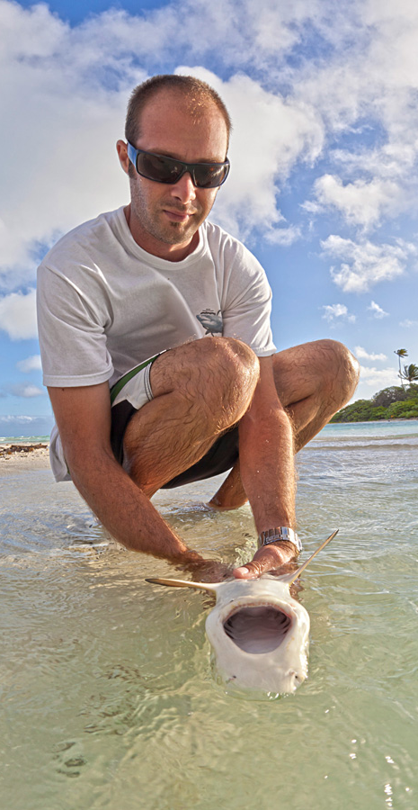
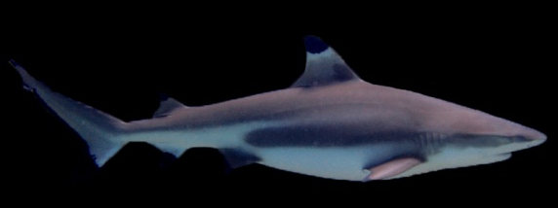
Inter-island reproductive migrations

Slide 14

Inbreeding
Mean IR (60 juveniles) = 0.038 → random mating (p = 0.06; 10 000 simulations)
but high proportion of inbred juveniles
IR_{max} = 0.59 (>0,5 → fullsibling or parent/offspring mating)
8% of IR > 0.25 et 32% of IR > 0.15
Correlate with the inefficient inbreeding avoidance strategy found with social network analyses

Slide 15
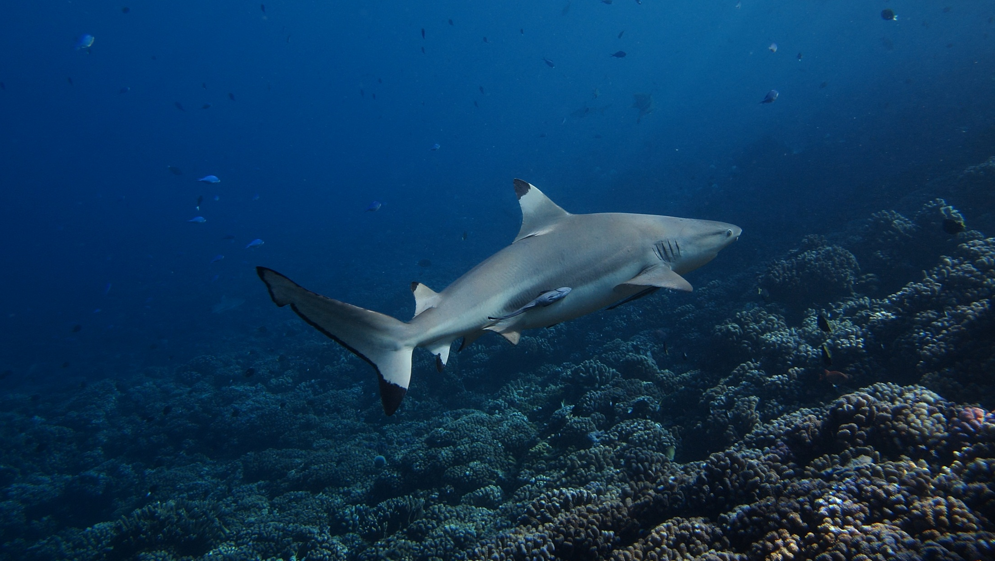
Key results:
Fine-scale subdivision of the population into social communities
Dynamic social structure but with an inefficient inbreeding avoidance strategy
Direct genetic evidence for reproductive philopatry, associated fine-scale migrations, but relatively high level of inbreeding
Shark population structure can be complex
Other studies on shark aggregations may benefit from such fine-scale analytical approaches
better understand the causes and consequences of group living in these top predators.

Slide 16
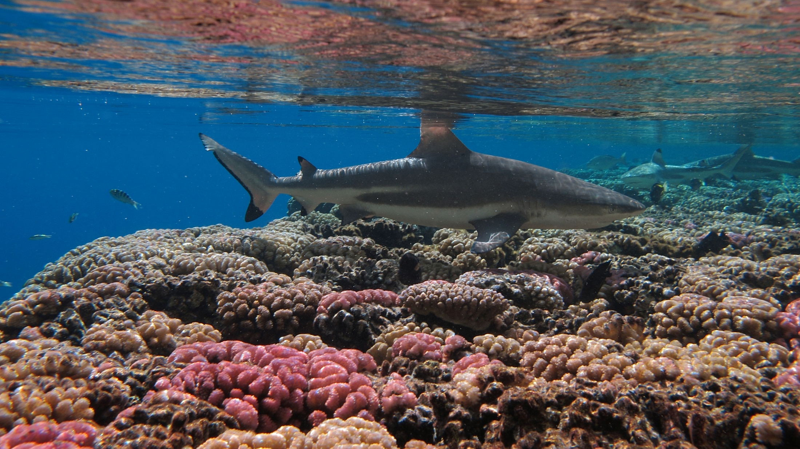
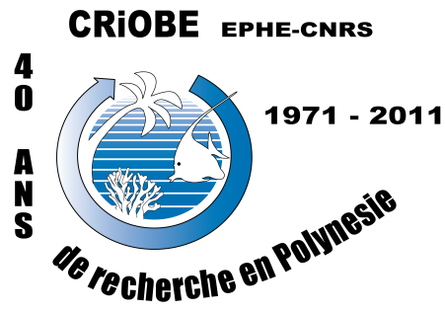

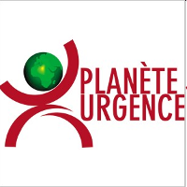



Acknoledgments
Laboratoire d'Excellence « CORAIL »
USR 3278 EPHE-CNRS, CRIOBE
Centre de Biologie et d'Ecologie Tropicale et Méditerranéenne
Université de Perpignan,
52 Av. Paul Alduy 66860 Perpignan cedex,
France
Email: johann.mourier@gmail.com
CRIOBE:
Serge Planes
René Galzin
Thomas Vignaud
Julie Vercelloni
Advices on social networks
David Lusseau
Hal Whitehead
Assistance on the field:
Planête Urgence (volunteers)
Teman o Te Moana
Fundings:
ProScience
Service de la pêche
French polynesian governement

